Slide 1
Handwritten Digit Recognition
Chris Heelan (cjh276)
Bok Young Kim (bk294)

Slide 2



The Challenge
Train a program to recognize handwritten digits from the MNIST database
Digits are 24x24 pixel 8-bit grayscale images

Slide 3
Feature Selection
Grayscale vectors (each feature is an integer from 0 to 255, with 0 being white)
Conversion to black and white using Otsu’s method
Otsu’s method calculates a threshold for each picture, which is more reliable over many pictures than using a single threshold

Slide 4
Learning Algorithms
Decision Trees
Experiment with different maximum depths
Random Forests
Experiment with the maximum depth for each tree, and the number of trees used
SVMs
Experiment with different kernels
C wasn’t helpful

Slide 5
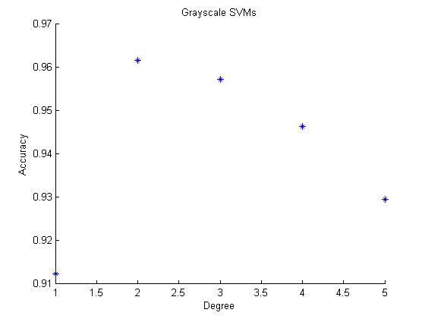
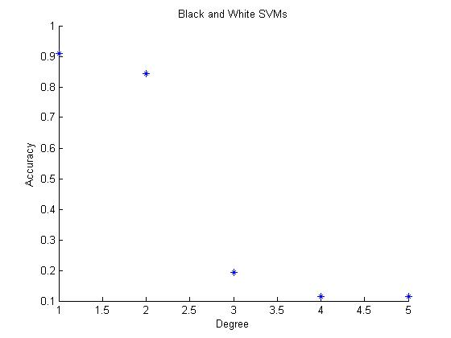
Results
Best results
SVMs: 96.17%
Random Forests: 95.05%

Slide 6




Sample Mistakes
The classifier made errors on digits that were poorly drawn – this is a good sign

Slide 7
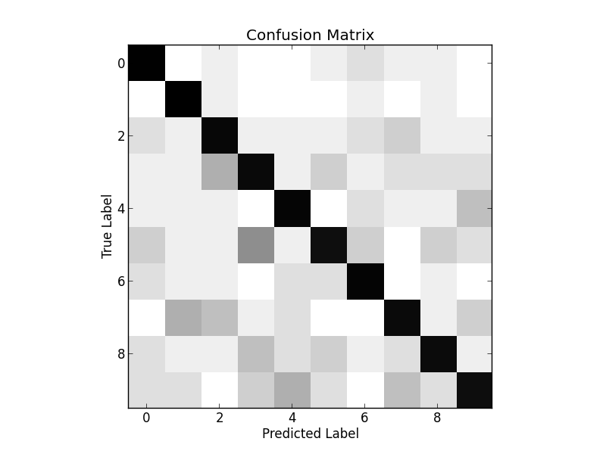
Confusion Matrix

Slide 8
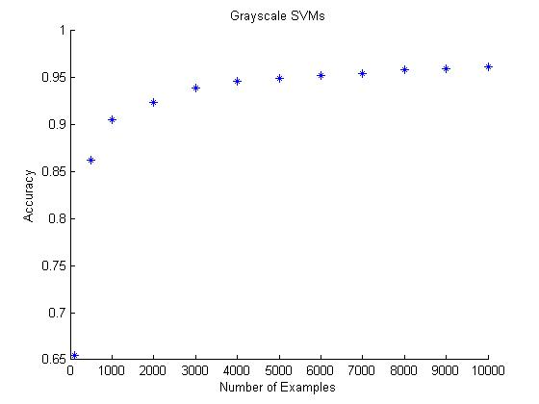
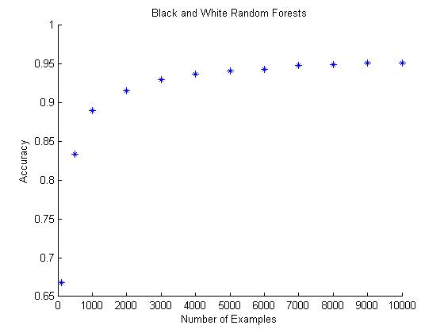
What if We Use Less Training Data?
Very good results even with half the training examples

Slide 9
Conclusion
96% accuracy is great
No significant difference between grayscale and black and white
It would be easy to extend this program to recognize all alphanumeric characters
Better with Random Forests than SVMs
Relatively few training examples needed to learn digit concepts
Good news if anyone wants to recognize more esoteric characters where training data isn’t widely available

